Slide 1
PET segmentation
&
MICCAI challenge
Baptiste Laurent
Laboratory of Medical Information Processing
LaTIM INSERM-UBO UMR 1101, Brest

Slide 2




Introduction
Segmenting PET images
PET segmentation
  Estimate volumes and boundaries of abnormal tissues
Applications
  Survival prognostic
  Radiotherapy planning
  Therapy monitoring
  Radiomics / tumor characterization

Slide 3
Introduction
Segmenting PET images: the need for accuracy
Stratification of patients according to volume
  Accuracy not very important
    Only need to preserve hierarchy between patients
Fuzzy locally adaptive bayesian (FLAB)
Adaptive thresholding
cm³
cm³
cm³
cm³
Hatt, et al. Prognostic value of 18F-FDG PET image-based parameters in oesophageal cancer and impact of tumour delineation methodology. Eur J Nucl Med Mol Imaging 2011

Slide 4
Introduction
Segmenting PET images: the need for accuracy
Radiotherapy planning
  Accuracy very important
    Sensitivity > positive predictive value
Le Maitre, et al. Impact of the accuracy of automatic tumour functional volume delineation on radiotherapy treatment planning. Phys Med Biol 2012

Slide 5
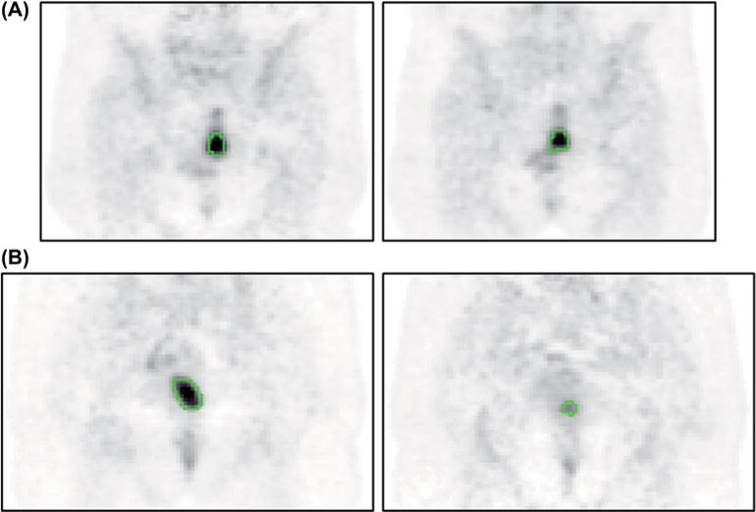
Introduction
Segmenting PET images: the need for accuracy
Therapy monitoring
  Accuracy very important
    Positive predictive value > sensitivity
Hatt, et al. Early prediction of pathological response in locally advanced rectal cancer based on sequential 18F-FDG PET. Acta Oncol 2013

Slide 6
Introduction
Segmenting PET images: the need for accuracy
Radiomics / tumor characterization
  Accuracy could be very important
    Especially for shape descriptors
    Some textural features are also highly sensitive
M. Hatt, et al. Tumor functional sphericity from PET images: prognostic value in NSCLC and impact of delineation method. Eur J Nucl Med Mol Imaging (in press) 2017
M. Hatt, et al. Robustness of intratumour ¹⁸F-FDG PET uptake heterogeneity quantification for therapy response prediction in oesophageal carcinoma. Eur J Nucl Med Mol Imaging 2013

Slide 7
Introduction
PET image segmentation: challenges

Slide 8
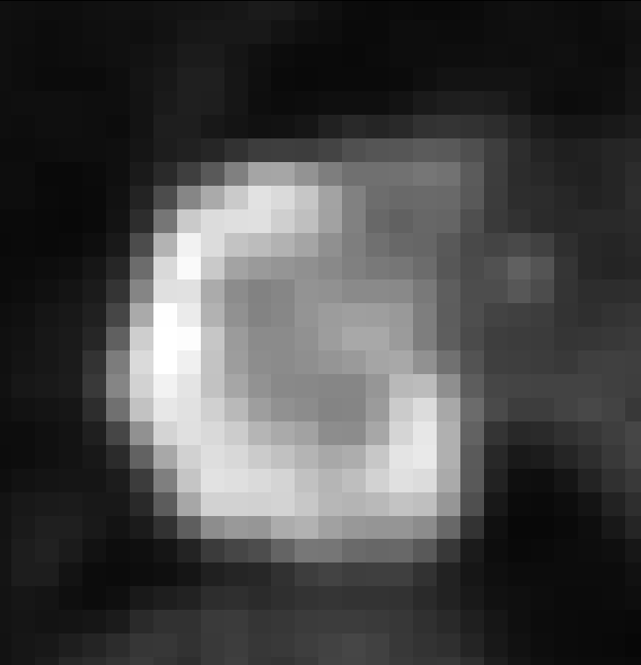
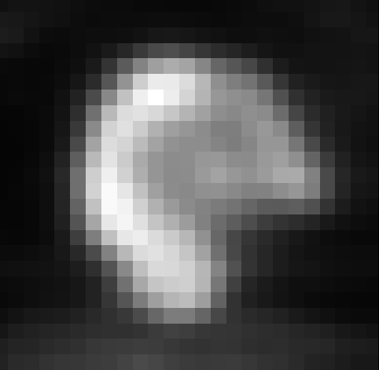
Introduction
PET image segmentation: challenges
PET direct segmentation
Limited signal-to-noise ratio
(sensitivity, acq. duration…)
Partial volume effects
(spatial resolution ~ 5 mm FWHM)
Spatial sampling
(voxel size ~ 2 – 5 mm)
Uptake heterogeneity
Range of shape complexity
Manual segmentation unreliable (high intra and inter variability)
There is no single threshold value adequate for all cases
Binary segmentation can be insufficient
M. Hatt, et al. Metabolically active volumes automatic delineation methodologies in PET imaging: Review and perspectives. Cancer Radiother 2011
J.A. Lee. Segmentation of positron emission tomography images: some recommendations for target delineation in radiation oncology. Radiother Oncol. 2010

Slide 9
The era of thresholding
1997-2007
  One of the first papers (conference)
    Suggested the use of a fixed threshold of 42% of the max for most cases (except extreme ones)
  Numerous subsequent papers for thresholding¹
    Suggested other fixed threshold values
      between 30 and 80% of SUVmax / SUVpeak
      >SUV 2.5, 2.0 …
    Extended the paradigm to « adaptive » thresholding
      Iterative approaches
      Taking into account the background value and/or contrast
      Usually require optimization using phantom acquisitions
        For each scanner model
        For each acquisition protocol
A.-S. Dewalle-Vignion, et al. Les méthodes de seuillage en TEP : un état de l’art. Médecine Nucléaire 2010

Slide 10
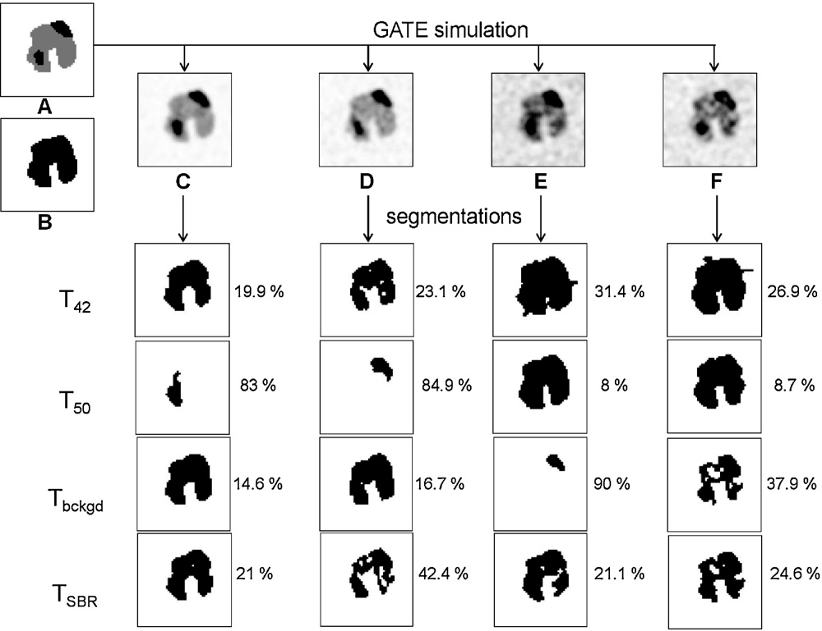
Thresholding: limitations
Fixed and adaptive thresholding
M. Hatt. Automatic determination of functional volumes for oncology applications. PhD thesis, University of Brest 2008.

Slide 11
The era of image segmentation
2007 and beyond
  Two « landmark » papers in 2007

Slide 12
The era of image segmentation
2007 and beyond
After 2007: surge of publications
B. Foster, et al. A review on segmentation of positron emission tomography images. Comput Biol Med. 2014

Slide 13
The era of image segmentation
State-of-the-art
  Categories of methods
Foster B, et al. A review on segmentation of positron emission tomography images. Comput Biol Med. 2014

Slide 14
The era of image segmentation
State-of-the-art
  Categories of methods
B. Foster, et al. A review on segmentation of positron emission tomography images. Comput Biol Med. 2014

Slide 15
The era of image segmentation
State-of-the-art
  Categories of methods
B. Foster, et al. A review on segmentation of positron emission tomography images. Comput Biol Med. 2014

Slide 16
The era of image segmentation
State-of-the-art
  Categories of methods
B. Foster, et al. A review on segmentation of positron emission tomography images. Comput Biol Med. 2014

Slide 17
PET segmentation
State-of-the-art
  Until recently:
    A large number of studies trying to optimize some kind of basic binary threshold (iterative methods, etc.)
    Existing image segmentation paradigms simply applied and/or adapted to PET or PET/CT
    In both cases validation often insufficent / incomplete
    Implementation by vendors is limited (some popular approaches such as region growing, adaptive thresholding, gradient-based…)
M. Hatt, et al. Classification and evaluation strategies of auto-segmentation approaches for PET: Report of AAPM task group No. 211. Med Phys. 2017

Slide 18
PET segmentation
State-of-the-art
  Until recently:
    User intervention remains crucial
      To identify and/or isolate the object of interest
      Sometimes to initialize parameters (seeds, etc.)
      To validate and/or edit the result
  Recent developments towards:
    Consensus / ensemble techniques
    Machine learning
    Multimodal (PET/CT, PET/MR, PET/CT/MR) methods
M. Hatt, et al. Classification and evaluation strategies of auto-segmentation approaches for PET: Report of AAPM task group No. 211. Med Phys. 2017

Slide 19


AAPM Task group 211
Creation and objectives
  Task Group No. 211 - Classification, Advantages and Limitations of the Auto-Segmentation Approaches for PET
  Started 2011
  Objectives :
    Review the state of the art
    Evaluate critically both methods and their evaluation
    Propose a benchmark and evaluation methodology guidelines
http://www.aapm.org/org/structure/default.asp?committee_code=TG211

Slide 20
AAPM Task group 211
Motivation and context
TG 211 report 1
    “Given the large number of published PET-AS algorithms, their different level of validation and because most of these published algorithms are not yet implemented in commercially available software, the selection of one recommended method is challenging and premature”
Hatt, et al. Classification and evaluation strategies of auto-segmentation approaches for PET. Report of the American Association of Physicists in Medicine Task group 211. Med Phys. 2016 (in press)

Slide 21
AAPM Task group 211
Motivation and context
TG 211 report 1
    “Clearly, further research (…) is needed, and one potential solution for going forward is the creation of a standardized protocol (i.e., a benchmark) (…)
    the benchmark needs to consist of several image datasets of different types: experimental (phantoms), numerically simulated and clinical, in order to compensate for the deficiencies of each of them (…). The performance of the methods needs to be evaluated using different metrics (…)”
Hatt, et al. Classification and evaluation strategies of auto-segmentation approaches for PET. Report of the American Association of Physicists in Medicine Task group 211. Med Phys. 2016 (in press)

Slide 22
PET segmentation challenge
Previous challenges
  Quantitative Imaging Network (QIN) PET Segmentation Challenge¹
    Only phantom data (available through TCIA website)
    No update since 10/2013
  Turku PET Centre contouring challenge²
    Numerous methods but limited amount of images (only 1 phantom)
    Focus on radiotherapy treatment planning
  No MICCAI challenge on PET image segmentation
1. http://michallenges.org/petSegmentationChallenge/
2. Shepherd, et al. Comparative study with new accuracy metrics for target volume contouring in PET image guided radiation therapy. IEEE Trans Med Imaging. 2012

Slide 23
PET segmentation challenge
Objectives of the first MICCAI PET challenge:
  1. Evaluate and compare methods accuracy with rigorously chosen performance metrics
  2. Provide large datasets of various images types with rigorous ground truth
  3. Provide an online platform to run and evaluate methods, to reach an objective and standardized evaluation protocol.

Slide 24
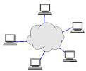













IAM Computing/Data Architecture
PET Challenge
Internet
VIP
OntoVIP
ArchiMed
LAN
Private
servers
(MOTEUR)
Black
Board
(Oncology)
BRAINVisa
Private
servers
LAN
CARMIN
API
Onto
Neurolog
FLI-IAM Web portal
PC
Information
System and
Search Engine
(Psychiatry)
(BrainVisa)
Metadata
Catalogs
(instance 1)
FLI@compute
FLI@Compute
FLI@Interoperability
(instance 2)
MedInria
XDS/XCA
Onto
Neurolog
FLI@Access
(MS)
PC
LAN
Submission
Private
servers
(ITK/ANIMA)
CATI (capsul)
CATIdb
LAN
(BrainVisa)
Private
clusters
LAN
Private
servers
(Memory)

Slide 25
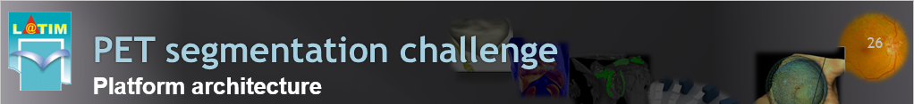
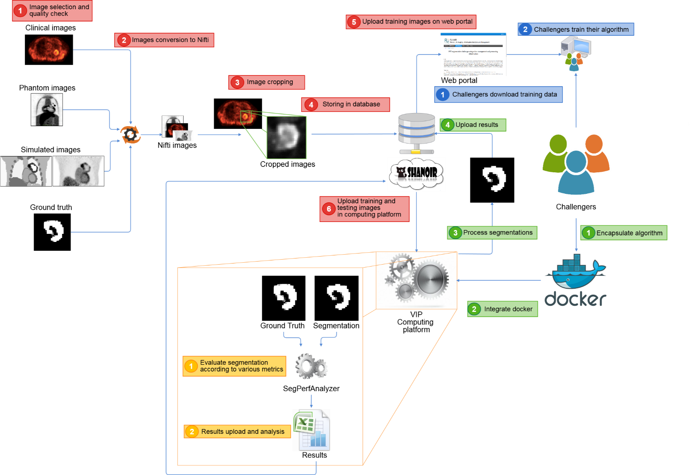
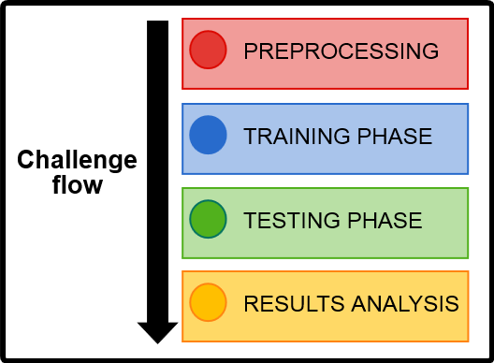
PET segmentation challenge
Platform architecture
Training / Testing
4 / 21
9 / 66
6 / 70
Total:
19 / 157
M. Hatt, et al. The first MICCAI challenge on PET tumor segmentation. Medical Image Analysis 2018

Slide 26
PET segmentation challenge
Organization details, participants
Registered participants
  5/12 explained not having the time/manpower to take care of the pipeline integration, no answer from the 7 others.
  Perhaps some renounced based on results obtained on the training set?
Steps | Number of participants | Number of pipelines
Registration and download of training data | 16
Submission of a paper | 4
Pipelines integration and testing data | 4 | 10

Slide 27
PET segmentation challenge
Evaluated methods
13 methods were compared (10 challengers and 3 reference methods : FLAB, T40, T50)
ACO(s) and (d) = ant colony algorithm with static or dynamic initialization
  Fayad, et al. J Nucl Med 2015;56:1745
ARG = adaptive region growing + curvature strategy
  Tan, et al. Med Phys 2017;62:5383-5402
CNN = convolutional neural network (using only the available training data)
  Krizhevsky, et al. Advances in neural information processing systems 2012;1097-1105
DICT = dictionary model (+ pre/post-processing for noise/morphology)
  Dahl & Larsen. British Machine Vision Conference 2011
FLAB = fuzzy locally adaptive Bayesian
Hatt, et al. IEEE Trans Med Imaging 2009;28:881-893
GARAC = gradient-aided region-based active contour
Jaouen, et al. IEEE NSS-MIC 2016
GMM = gaussian mixture model (+ pre/post-processing for noise/morphology)
Aristophanous, et al. Med Phys 2007;34:4223-4235
KM = k-means (+ pre/post-processing for noise/morphology)
Arthur & Vassilvitskii. ACM-SIAM Symposium on Discrete Algorithms 2007
SDWFCM = spatial-distance weighted fuzzy c-means (+ pre/post-processing for noise/morphology)
  Guo, et al. Wseas Trans. Comput. 2015;14:369-381
RF = random forest on image features (incl. textures)
Breiman, et al. Mach. Learn. 2001;45;5-32
T40 and T50 = threshold at 40 and 50% of max
M. Hatt, et al. The first MICCAI challenge on PET tumor segmentation. Medical Image Analysis 2018

Slide 28
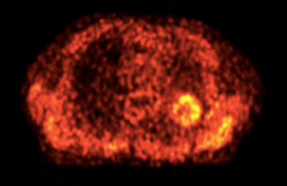
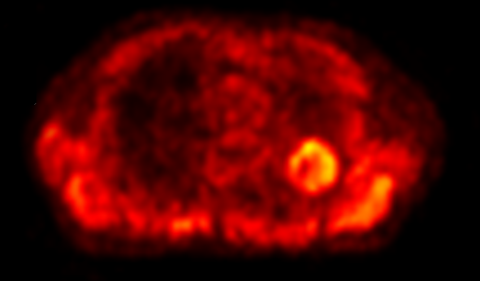
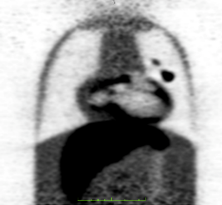
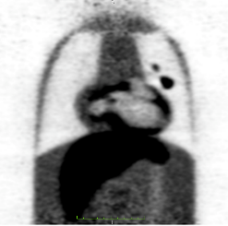
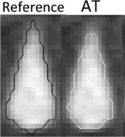
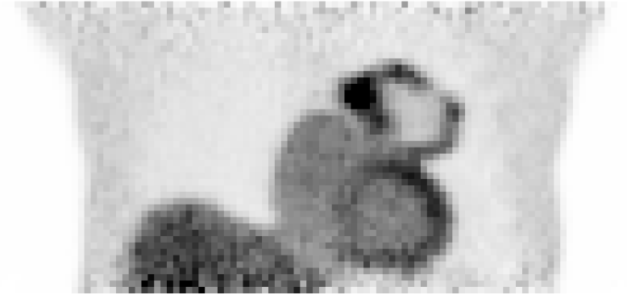
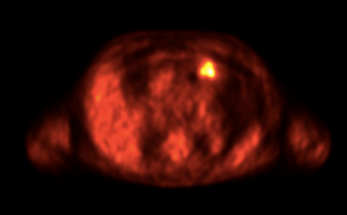
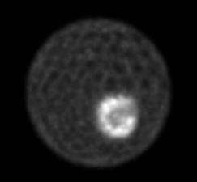
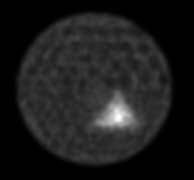
PET segmentation challenge
Data and evaluation protocol
Datasets: 3 types of data (19 training - 149 testing)
Clinical images
Physical phantoms
Numerical phantoms (Monte Carlo)
Analytical simulations
JF. Daisne, et al. Radiology 2004
T. Shepherd, et al. IEEE TMI 2012
M. Hatt, et al. IJROBP 2010
J. Lapuyade-Lahorgue, et al. Med Phys 2015
N=25
F. Zito, et al. Med Phys 2012
B. Berthon, et al. Med Phys 2014
N=66
A. Le Maitre, et al. Proceedings of the IEEE 2009
P. Papadimitroulas, et al. Med Phys 2013
M. Aristophanous, et al. Phys Med 2008
B. Berthon, et al. Phys Med. 2015
N=95 (18 testing excluded)

Slide 29
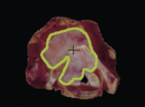
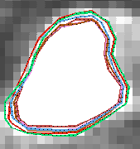
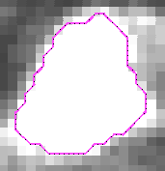
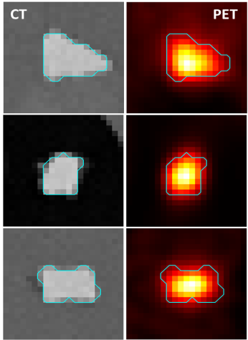
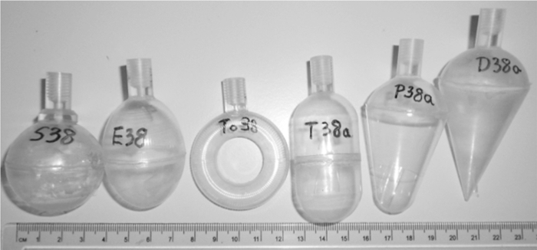
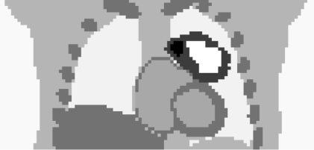
PET segmentation challenge
Data and evaluation protocol
Datasets: 3 types of associated ground-truth
Clinical images
Physical phantoms
Simulations
  Monte Carlo
  Analytical simulations
Digitized histopathology
Consensus of multiple expert delineations
Truth masks of sub-voxel precision from thresholding of associated CT
Absolute truth as used in image generation

Slide 30
PET segmentation challenge
Data and evaluation protocol
Type of data and ground-truth
Clinical images
Physical phantoms
Simulations
Surrogate of truth only
Real cases
Reliability of ground-truth
Realism of data/image
Reliable ground-truth with some limitation
Real acquisitions of simplistic objects
Very reliable ground-truth
Simulations with varying levels of realism in both object and image generation

Slide 31
PET segmentation challenge
Evaluation metrics
M. Hatt, et al. Report of AAPM TG211: Classification and evaluation strategies of auto-segmentation approaches for PET. Med Phys 2017

Slide 32
PET segmentation challenge
Data and evaluation protocol
Statistical analysis
  Comparison of metrics distributions (not normal) using Mann-Whitney rank-sum test
Max
75 percentile
Median
25 percentile
Min
Outside value
< or > lower/upper quartile ± 1.5 × interquartile range
Far out value
< or > lower/upper quartile ± 3 × interquartile range
Method 1
Metric
Method 2

Slide 33
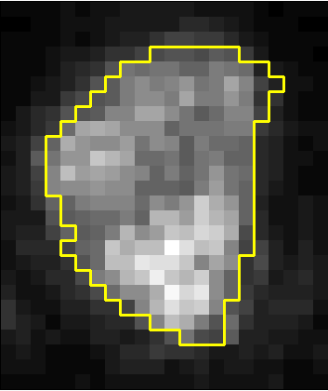
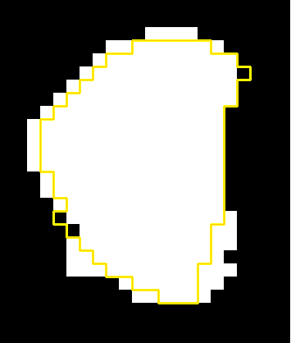
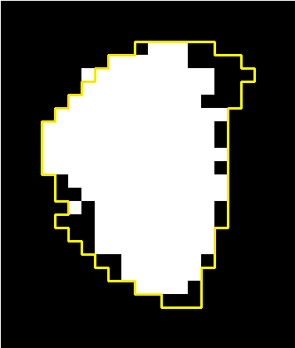


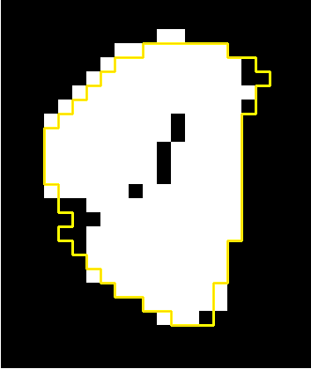
PET segmentation challenge
Results for best methods of each team
Visual examples – agreement on clinical image
Original PET
ACO
ARG
Surrogate of truth
GARAC
CNN

Slide 34
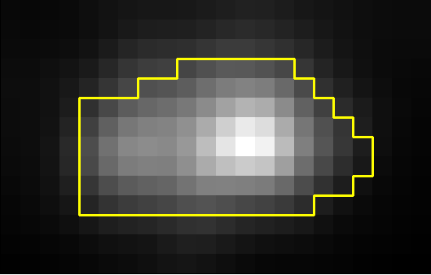



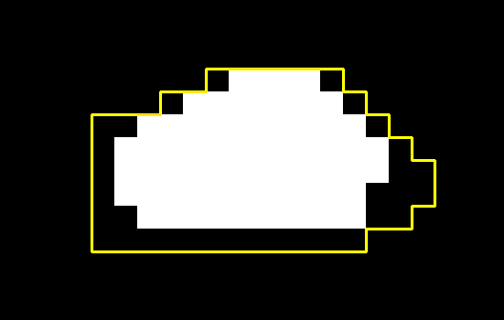

PET segmentation challenge
Results for best methods of each team
Visual examples – agreement on phantom image
Original PET
ACO
ARG
Ground-truth
GARAC
CNN

Slide 35
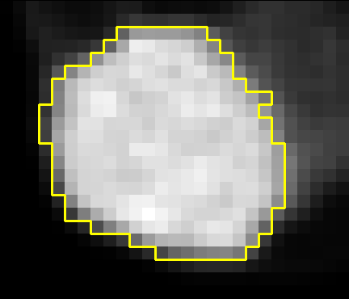




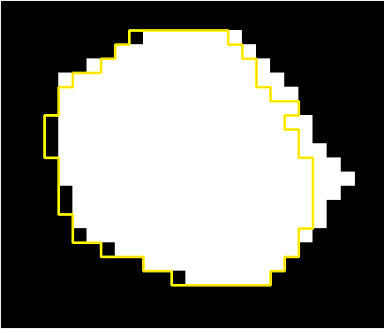
PET segmentation challenge
Results for best methods of each team
Visual examples – agreement on simulated image
Original PET
ACO
ARG
Ground-truth
GARAC
CNN

Slide 36
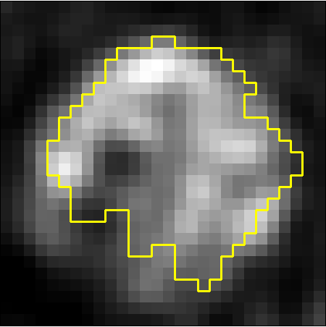
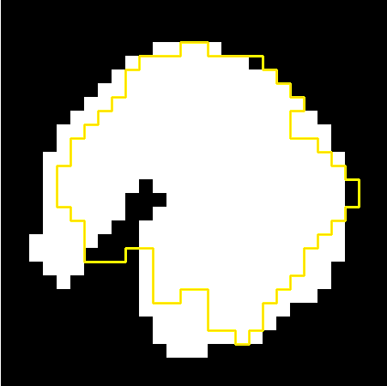


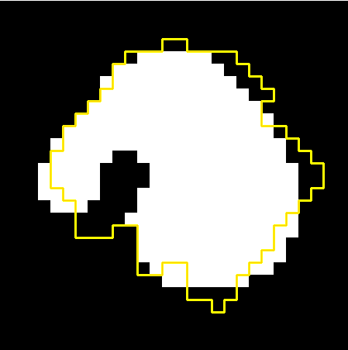

PET segmentation challenge
Results for best methods of each team
Visual examples – disagreement on clinical image
Original PET
ACO
ARG
Surrogate of truth
GARAC
CNN

Slide 37
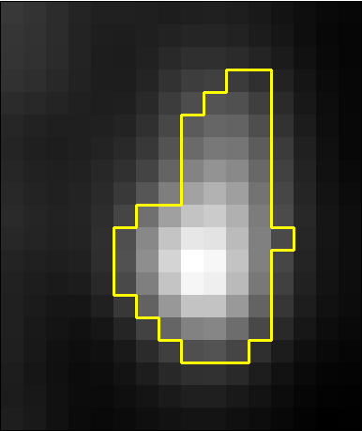
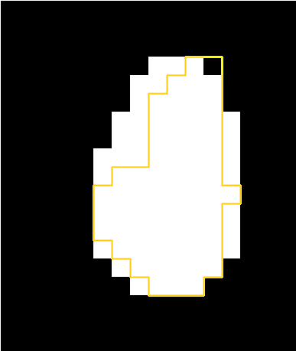
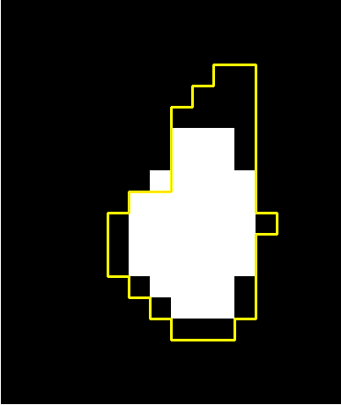

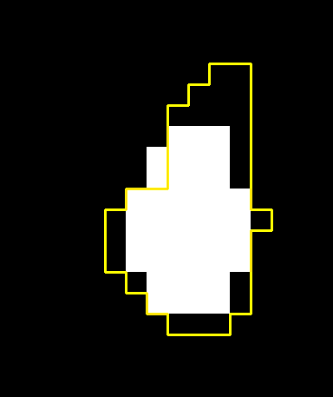
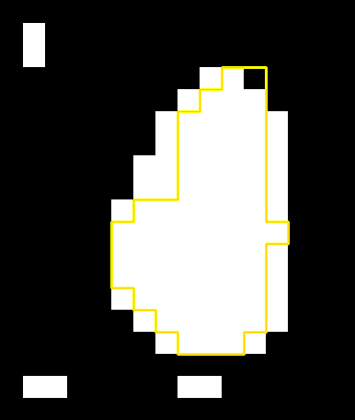
PET segmentation challenge
Results for best methods of each team
Visual examples – disagreement on phantom image
Original PET
ACO
ARG
Ground-truth
GARAC
CNN

Slide 38
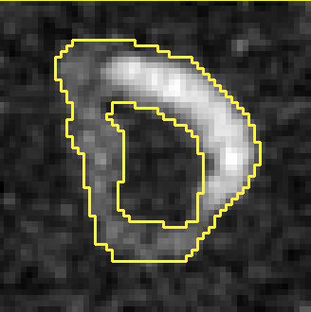
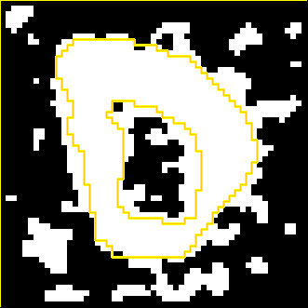
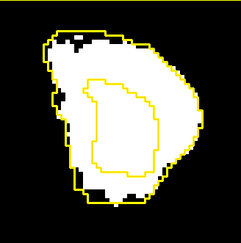

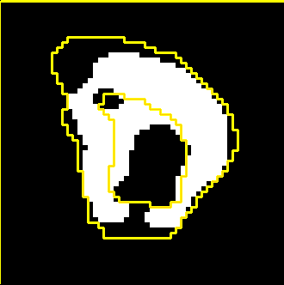
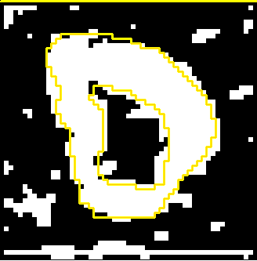
PET segmentation challenge
Results for best methods of each team
Visual examples – disagreement on simulated image
Original PET
ACO
ARG
Ground-truth
GARBAC
CNN

Slide 39
PET segmentation challenge
Results
  Sensitivity Positive Predictive Value (PPV)
M. Hatt, et al. The first MICCAI challenge on PET tumor segmentation. Medical Image Analysis 2018

Slide 40
PET segmentation challenge
Results
  Accuracy (mean of SE and PPV)
M. Hatt, et al. The first MICCAI challenge on PET tumor segmentation. Medical Image Analysis 2018

Slide 41
PET segmentation challenge
Results
Metrics according to applications
  If we assume
    SE is more important than PPV for radiotherapy planning (gross tumor volume definition)
    PPV is more important than SE for response assessment (extraction of quantitative metrics)
Application | SE | PPV
Pure segmentation (this challenge) | 0.5 | 0.5
Radiotherapy planning | 0.6 | 0.4
Therapy follow-up | 0.4 | 0.6

Slide 42
PET segmentation challenge
Results for best methods of each team
Metrics according to applications
0.4 × PPV + 0.6 × SE (RT planning)
ACO
ARG
GARAC
CNN
T40
T50
FLAB

Slide 43
PET segmentation challenge
Results for best methods of each team
Metrics according to applications
0.6 × PPV + 0.4 × SE (Therapy follow-up)
ACO
ARG
GARAC
CNN
T40
T50
FLAB

Slide 44
PET segmentation challenge
Results for best methods of each team
Comparison according to other metrics
Dice
ACO
ARG
GARAC
CNN
T40
T50
FLAB

Slide 45
PET segmentation challenge
Results for best methods of each team
Comparison according to other metrics
Jaccard
ACO
ARG
GARAC
CNN
T40
T50
FLAB

Slide 46
PET segmentation challenge
Discussion
Overall observations
  All 4 methods performed well
    Significantly better than both fixed thresholds
      (0.75-0.85 for teams vs. <0.6 for thresholds, p<0.0001)
    Only one method (CNN) significantly outperformed state-of-the-art FLAB method (p=0.0007)
  The methods performance decreases with the reliability of the ground-truth / realism of data
    Simulated data > phantom acquisitions > clinical images

Slide 47
PET segmentation challenge
Discussion
Overall observations
  The results highlighted a clear hierarchy
    which does not depend strongly on either
      type of dataset (except for clinical data for which the differences are less pronounced)
      or metric used
      or applications (favor SE or PPV)
SE+PPV, Jaccard, Dice
Rank | Method | Significant?
1 | CNN (team 4)
2 | ACO (team 1)
3 | ARG (team 2)
4 | GARAC (team 3)
Yes*
Yes***
Yes*
Yes***

Slide 48
PET segmentation challenge
Results
  Ensemble techniques
M. Hatt, et al. The first MICCAI challenge on PET tumor segmentation. Medical Image Analysis 2018

Slide 49
PET segmentation challenge
Results for best methods of each team
Runtime (for the 149 testing data)
 | Mean | ACO | ARG | GARAC | CNN
Runtime (min) | 6h00 | 4h04 | 9h20 | 3h39 | 7h00
Relative Runtime (%) | 1 | 0,67 | 1,55 | 0,61 | 1,16

Slide 50
PET segmentation challenge
Limitations and perspectives
  Not evaluated in the challenge:
    Robustness with respect to
      noise levels
        images with # levels of noise
      multicentric data
        images of same object in # scanners
    Reproducibility/repeatability and user-interaction
      multiple runs of pipelines on VIP
      user interaction, manual parameters…
    Numerous other methods!

Slide 51
PET segmentation challenge
Benchmark extensions
    Addition of methods / metrics
    Addition of recently developed datasets:
B. Berthon, et al. A novel phantom technique for evaluating the performance of PET auto-segmentation methods in delineating heterogeneous and irregular lesions. EJNMMI Phys 2015
CD. Soffientini, et al. Technical Note: A new zeolite PET phantom to test segmentation algorithms on heterogeneous activity distributions featured with ground-truth contours. Med Phys 2017

Slide 52
Thanks for your attention

Slide 53




Acknowledgments
AAPM TG 211
Assen Kirov, Emiliano Spezi, John A. Lee, Michalis Aristophanous, Shiva Das, Issam El Naqa, Robert Jeraj, Wei Lu, Osama Mawlawi, Béatrice Berthon, Elisabetta De Bernardi, Charles Schmidtlein, Dimitris Visvikis, Aditya Apte, Paulina Galavis, Andrei Pugachev, Habib Zaidi, Ursula Nestle, Arden Nelson, Heiko Schöder, Michael MacManus, Vincent Grégoire, Xavier Geets
MICCAI challenge
Challengers
Anouar Ouahabi, Hadi Fayad
Vincent Jaouen, Clovis Tauber
Shan Tan, Laquan Li, Wei Lu, Shuaiwei Liu, Xu Huang
Jakub Czakon, Filip Drapejkowski, Witold Dyrka, Piotr Giedziun, Grzegorz Żurek, Jakub Szewczyk, Piotr Krajewski, Jacek Żebrowski
Organization
FLI: Christian Barillot, Michel Dojat
FLI-IAM: Baptiste Laurent, Michael Kain, Yao Yao, Mathieu Simon, Aneta Morawin, Julien Louis, Simon Loury
VIP platform: Tristan Glatard, Sorina Camarasu-Pop, Frédéric Cervenansky, Pascal Girard
Other: Federico Turkheimer, Olivier Commowick, Catherine Cheze Le Rest
Sponsorship - funding
France Life Imaging (grant ANR-11-INBS-0006 from the French “Investissements d’Avenir” program).
NIH/NCI Grant R01CA172638 and the NIH/NCI Cancer Center Support Grant P30 CA008748
Support Programme of the Partnership between Higher Education and Science and Business Activity Sector financed by City of Wroclaw

